Slide 1
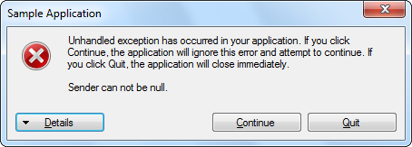
5. Throw an exception
Method N
Method N
…
4. Method call
…
6. Find handler
Method 2
Method 2
3. Method call
7. Find handler
Method 1
Method 1
2. Method call
8. Find handler
Main()
Main()
.NET CLR
1. Execute the
program
9. Find handler
10. Display error message

